Slide 1
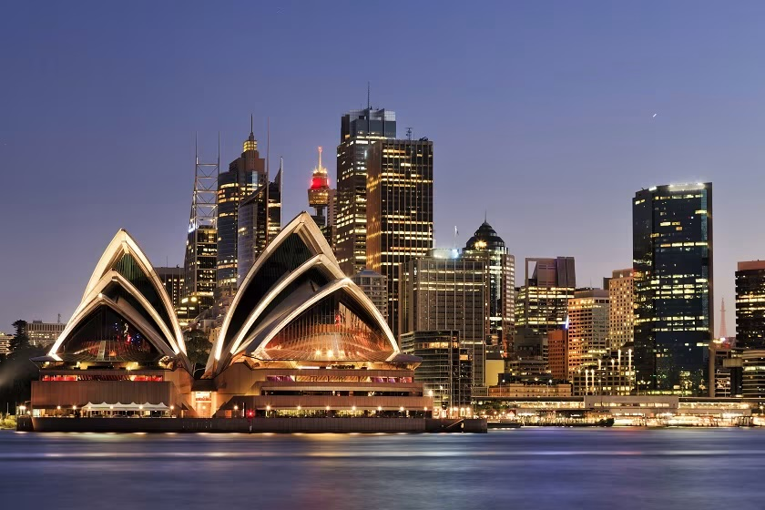

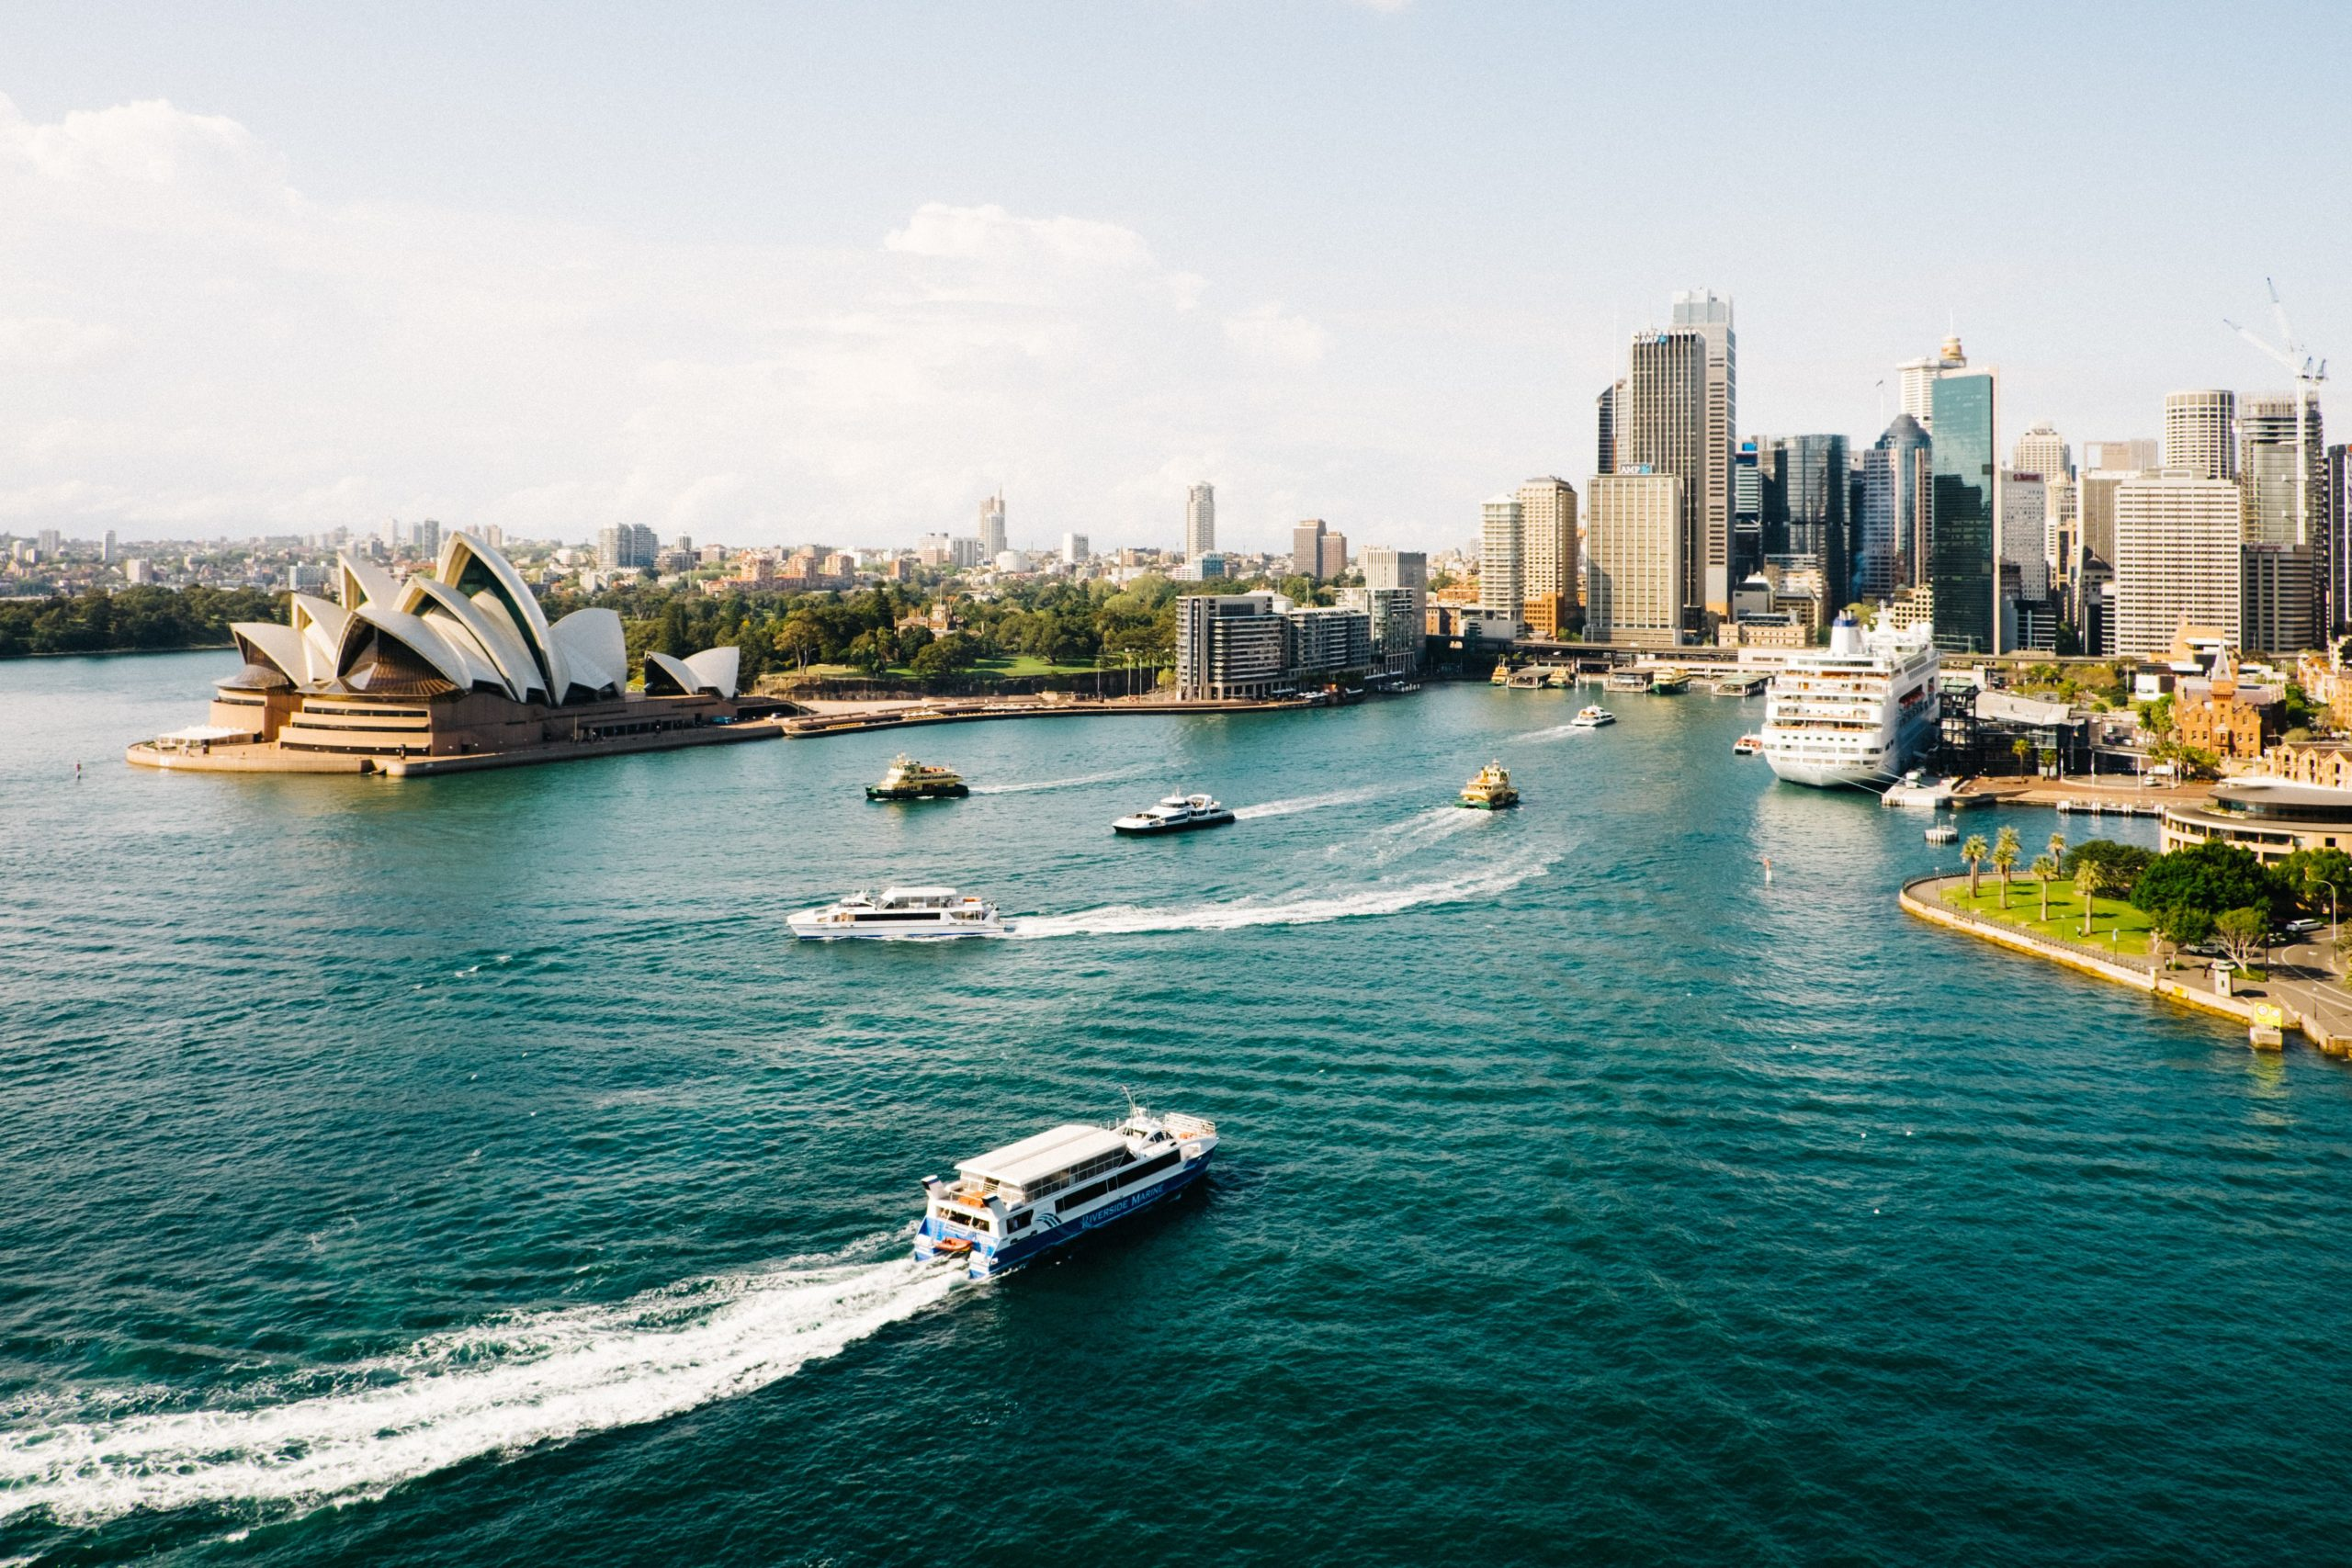
A U S T R A L I A
Sydney
The Harbour City
01
Multicultural
02
Waterfront
03
Vibrant

Slide 2
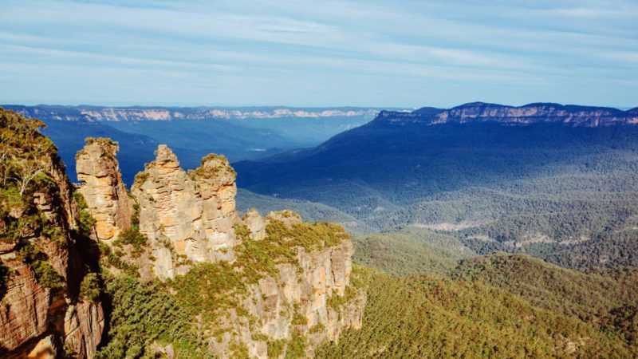

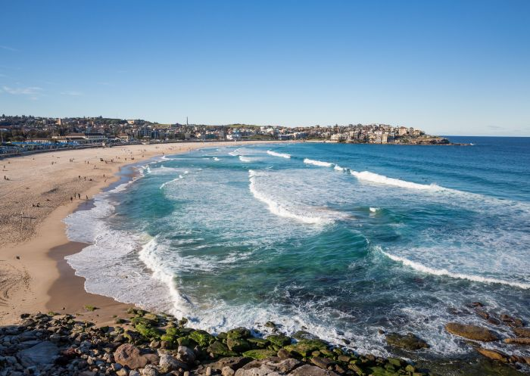
Blue Mountains
N A T U R E O F S Y D N E Y
Bondi Beach

